Slide 1


Welcome to the 2024 Open House
University of Louisiana at Lafayette
Department of Communicative Disorders

Slide 2

Academic Graduate Faculty
Dr. Elena Babatsouli
Dr. Michael Cannito
Dr. Judith Oxley
Dr. Christine Weill
Dr. Jamie Azios
Dr. Michael Azios
Dr. Laura Arrington
Dr. Ryan Nelson
Dr. Pat Rydell
Dr. Holly Damico
Dr. Natalie Douglass

Slide 3
Full-time Clinical Faculty
Mrs. Ashley Kidd, Clinic Director
Mrs. Mona Breaux
Mrs. Katie Hays
Dr. Anne Williams
Mr. Derek Dupuis
Mrs. Kimberley Muirhead

Slide 4
Full-time ASL Instructors
Ms. Katie Potier
Ms. Leah Dawsey

Slide 5
Administrative
Ms. Roxie Harris
  Departmental Office, Room 236
Dr. Amanda Percle
  Clinic Operations and Outreach Coordinator
  Room 201

Slide 6
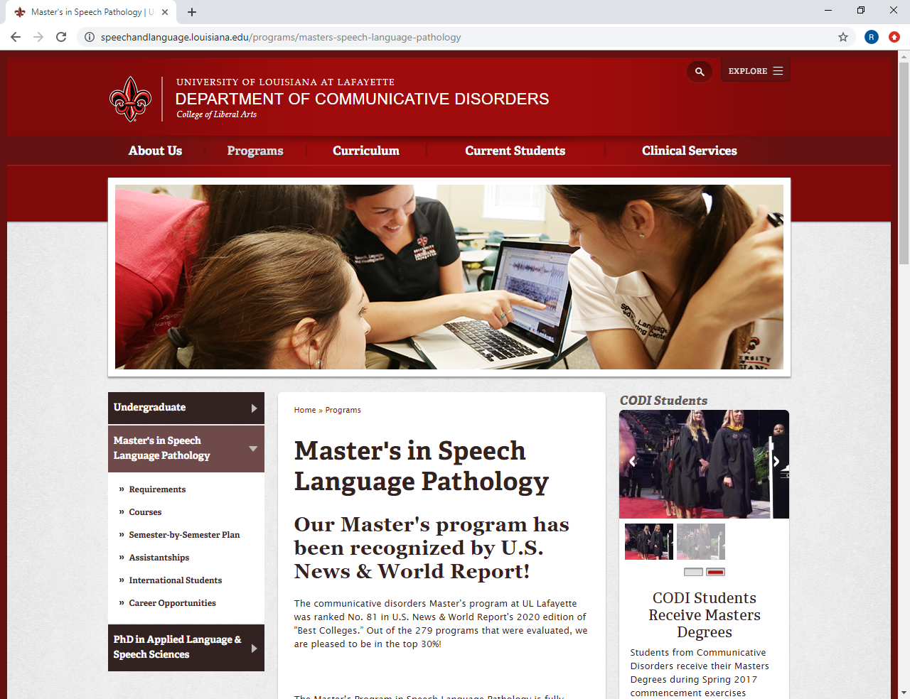
Departmental Website
http://speechandlanguage.louisiana.edu

Slide 7
APPLICATION MATERIALS
The application itself
Transcripts
Letters of Rec for ALL applicants
Response to Personal Prompts from ALL applicants
Resume

Slide 8
Tracking your Application
All information goes to the graduate school
Applications do not come to the department until they are complete
If you have questions about your application materials, contact the graduate school.
TRANSCRIPTS: from ALL degree granting institutions or where graduate coursework was attempted
  Including dual enrollment programs, community college, etc

Slide 9

Departmental Admission Requirements
Deadline for receipt of ALL admission documents in the graduate school office is January 10, 2025.
You are applying for the Summer, 2025 admissions class.
You will be starting the program June 2ish, 2025!
Once admitted and before starting coursework:
Background check
Drug screen
Review Core Functions Document

Slide 10
Additional Program Requirements
GRE Scores (official) are NOT required, but recommended
Personal Prompts
At least one course (can be picked up during the MS program)
  biology
  one course in chemistry or physics
  a basic statistics course
  and one course in behavioral science (e.g. psychology, anthropology, sociology)
  AURAL REHAB
Oral and Written Language Proficiency
  Students applying … “are expected to have writing and speaking abilities acceptable for purposes of employment as speech and language clinicians. Students who do not possess these skills will be expected to pursue remedial work.

Slide 11
Prerequisite or “leveling” Courses
Normal Speech and Language Development
Anatomy and Physiology of the Speech and Hearing Mechanism
Communication Science; Acoustics; Speech Science
Introduction to Audiology
Aural Rehabilitation
Phonetics
Articulation/Phonological Disorders
Language Disorders
Clinical Methods/Observation
Some recent flexible
pathways to the prereqs. Contact MS Grad Coordinator
Holly.damico@louisiana.edu

Slide 12
Curriculum
6 semesters
beginning summer, 2025and graduating spring, 2027
43 semester hours
10 required courses
12 hours of electives (minimum)
Capstone Seminar
5 semesters of clinical practicum + 1st summer Clinical Methods Orientation

Slide 13
Required Courses
CODI 500 Intro to Research
CODI 504 Voice Disorders
CODI 502 Communication Neuroscience
CODI 508 Aphasia
CODI 522 Speech Sound Disorders
CODI XXX Cognitive Communication
CODI 526 Language Disorders
CODI 528 Language and Literacy
CODI 531 Medical SLP-Swallowing
CODI 540 Stuttering
CODI 550 x 2 (elective options, total of 3 credits)
CODI 595 Capstone

Slide 14
Capstone
Takes the place of a comprehensive exam
Taken in the final semester (only offered in the spring)
Discussion/debate on 3-5 timely topics
MUST BE PASSED IN ORDER TO GRADUATE

Slide 15
Electives
Many electives offered through seminars with rotating topics
Examples
  Counseling
  Traumatic Brain Injury
  Current Topics in Dysphagia or Voice Research
  Motor Speech Disorders
  Deaf/Hard of Hearing Populations
  Autism Spectrum Disorders
  Dementia
  Multilingual/Multicultural
  Advanced Language Intervention
  Early Language Development & Intervention
  Craniofacial Anomalies
  Advanced Writing Assessment and Intervention
  Pediatric Neurogenic Disorders
  Advanced topics in Specific Disorders
  Gerontology
  Augmentative and Alternative Communication

Slide 16
Master's Degree
Semester-by-Semester Plan
YEAR ONE
YEAR TWO
Summer | Fall | Spring
CODI 500 RESEARCH | CODI 508 APHASIA | CODI 522 SPEECH SOUND
CODI 504 VOICE | CODI 526 LANG DIS | CODI 540 STUTTERING
CODI 510 CLINIC (1) | CODI XXX COG COMM | CODI 528 LANG LIT
 | CODI 502 COMM NEURO | ELECTIVE
 | CODI 510 CLINIC | CODI 510 CLINIC
Summer | Fall | Spring
CODI 510 CLINIC | CODI 550(2) ELECTIVE | CODI 550(1) ELECTIVE
CODI 531 SWALLOWING | ELECTIVE (3) | ELECTIVE (3)
 | ELECTIVE (3) | CODI 595 CAPSTONE
 | CODI 512 CLINIC | CODI 512 CLINIC
Notes:
Year one
F -24
Sp – 50-75
Su – 50-75
Year Two
F – 100-115
Sp – 100-115

Slide 17
Areas of Excellence & Specialty Projects

Slide 18

Language and Literacy Project

Slide 19
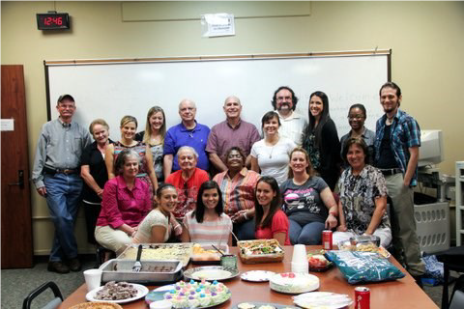
Aphasia Group Services

Slide 20
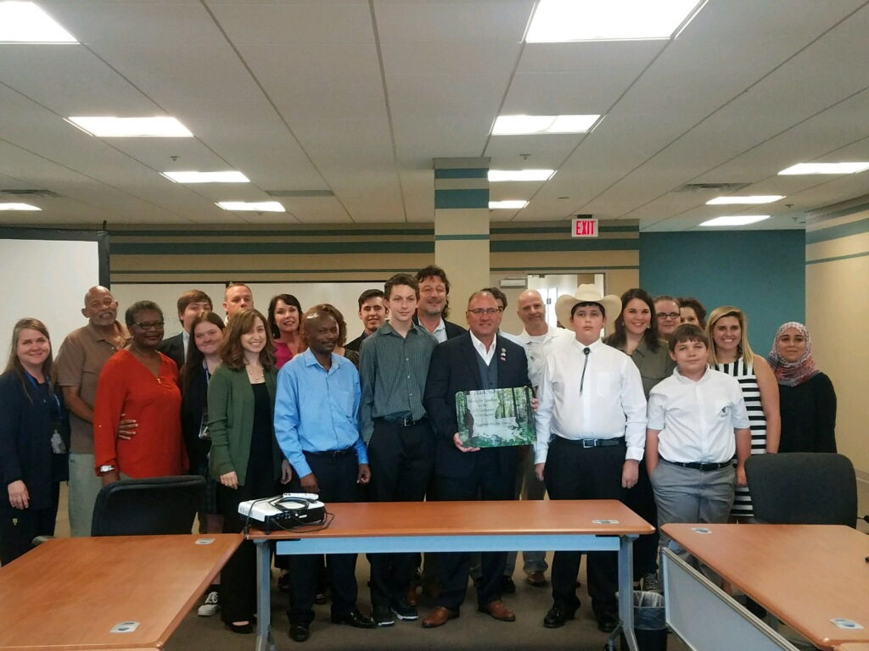
Stuttering Project

Slide 21
Additional Specialty Clinics
Early Language/Communication Preschool
Social Communication Groups
Augmentative and Alternative Communication
Amyotrophic Lateral Sclerosis (ALS) Voice Banking and Interdisciplinary Assessment

Slide 22

Advisors
An advisor will be assigned to you once you are accepted; the master’s program graduate coordinator will serve as advisor initially for summer and fall course scheduling
This Photo by Unknown Author is licensed under CC BY

Slide 23
Additional Information
There will be a separate orientation for newly admitted students during the summer term

Slide 24

Questions?

Slide 25
Fellowships/Assistantships
Graduate assistantships
  20 hrs of work per week (Fall & Spring); 10 hrs of work per week (summer)
  Tuition exemption plus a monthly stipend during the academic year; tuition exemption only in summer
  Currently $11,500/year
Fellowships
  Tuition waiver and monthly stipend
  No work requirement
  Highly competitive

Slide 26
Applying for Assistantship
To apply complete the graduate assistantship application found at http://gradschool.louisiana.edu/node/300
Submit with other application materials
Students who are enrolled full-time and admitted under regular status are eligible
Students admitted on conditional status are not eligible
Deadline for applying is March 1 (but submit with application Jan 10

Slide 27
Applying for Fellowship
Applications can be found at http://gradschool.louisiana.edu/node/300
Minimum eligibility requirements
  Undergraduate GPA of at least 3.5 or have earned no more than 12 hours in graduate school with a graduate GPA of at least 3.3
  GRE combined verbal and quantitative of at least 308
  Application deadline is February 1

Slide 28
McNair Scholars Program
Graduate school applicants who participated in and successfully completed the McNair Scholars Program as an undergraduate are eligible to receive a waiver of the graduate application fee and may be eligible for tuition exemption
For more information go to: http://gradschool.louisiana.edu/prospective-students/mcnair-graduate-scholars-program

Slide 29
Graduate School
Dr. Mary Farmer-Kaiser, Dean of Graduate School
https://gradschool.louisiana.edu/
Financial Aid
Cindy Perez, Director of Student Financial Aid
https://financialaid.louisiana.edu/
Housing
Dawn Miller, Interim Director
https://housing.louisiana.edu/

Slide 30

Student Connections
Each incoming cohort creates a social media group
  Most recently Groupme
  Meet your classmates
  Ask questions
  Look for housing/roommates

Slide 31
Trivia Challenge
Give yourself 1 point for each “yes”
Has a family member with a communication disorder
Has attended more than 1 undergraduate 4 year program
Has been to an ASHA convention
Played(s) collegiate level sports
Has been “scoped”
Started and finished undergrad in CODI/SLP
Right now, can name the cranial nerves in order (be careful, you might get asked to do it!)
Has read The Very Hungry Caterpillar at least 5 times

Slide 32
Is/was a member of NSSHLA for at least 1 year
  For 2 years
Birthday is yesterday, today or tomorrow
Had to “pretend stutter” for a class assignment
Has been to LSHA/other State convention
Applying to both SLP and AUD graduate programs

